Slide 1


Slide 2

Created an interactive, multi-page Power BI dashboard for ITC Hotels, designed to analyze key metrics including financial performance, booking behavior, occupancy trends, and room category performance. This solution delivers real-time insights, enabling stakeholders to use data-driven decision-making to optimize revenue, minimize cancellations, and enhance customer satisfaction.

Slide 3

Financial Overview & Revenue Performance

Slide 4
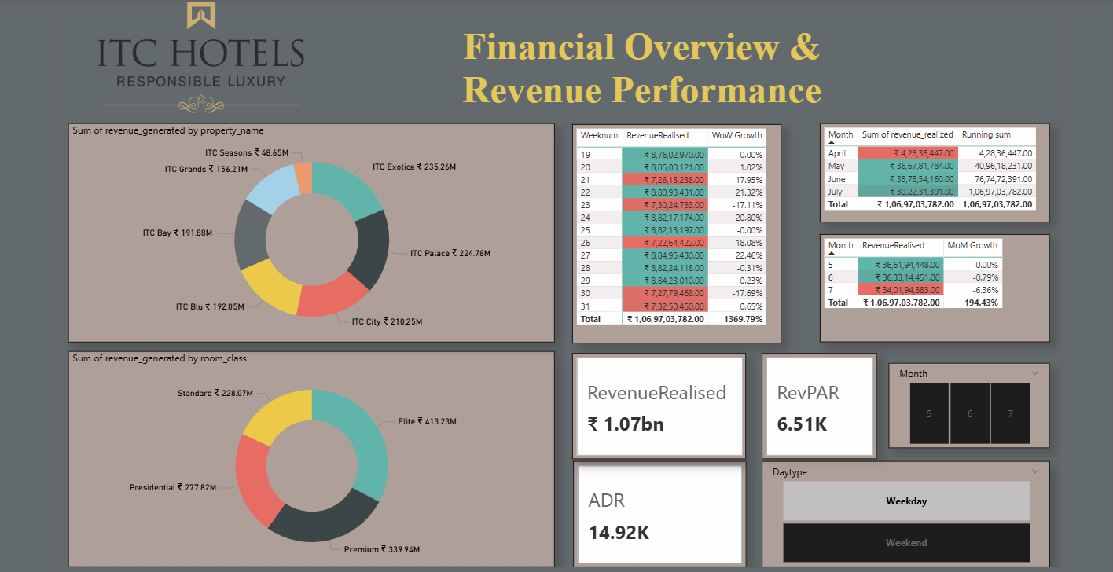

Slide 5

Generated ₹1.06+ billion revenue with strong WoW growth (136.79%), though recent MoM decline indicates an emerging slowdown.
Premium segments (Elite & Premium rooms) and top properties like ITC Exotica drive the majority of revenue.
High ADR (14.92K) and RevPAR (6.51K) reflect a strong luxury pricing strategy.
Weekday bookings dominate, with fluctuating weekly trends and lower weekend demand highlighting optimization opportunities

Slide 6

Occupancy & Capacity Analysis

Slide 7
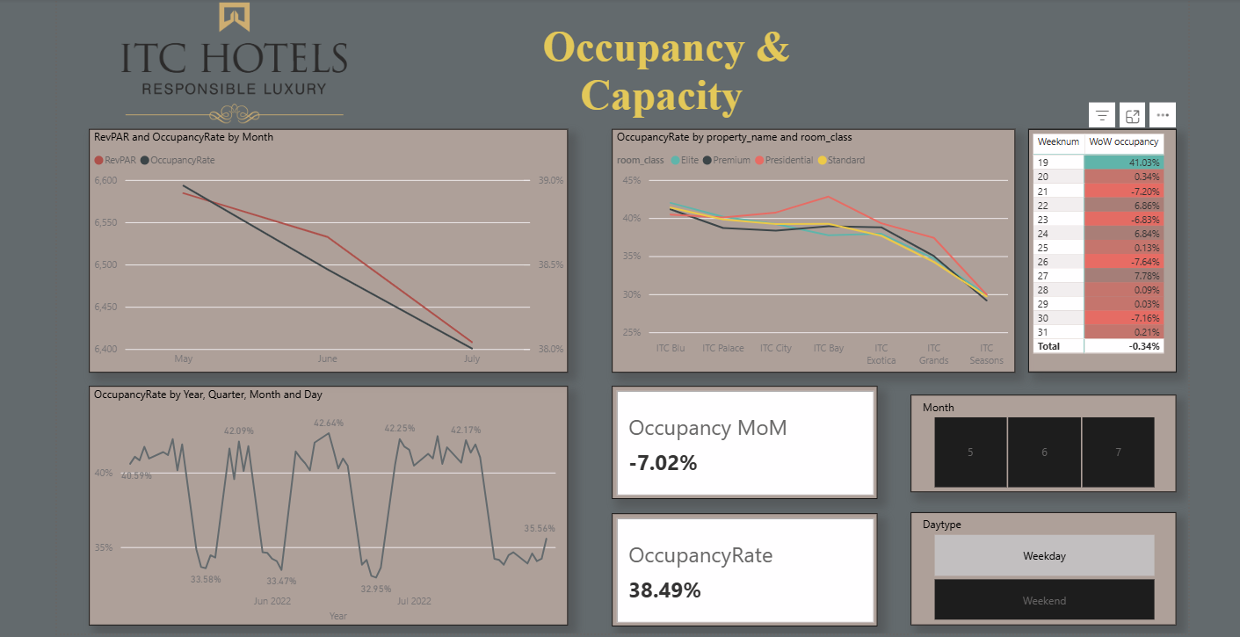

Slide 8
Declining Trend in Performance: Both RevPAR and Occupancy Rate show a consistent decline from May to July, indicating weakening demand or seasonal slowdown.
Negative Month-on-Month Growth: Occupancy dropped by -7.02% MoM, highlighting a significant short-term decline in hotel utilization.
Moderate Overall Occupancy: The overall occupancy rate stands at 38.49%, suggesting underutilized capacity across properties.
Variation Across Properties & Room Classes: Occupancy rates differ by property and room class, with premium and elite rooms performing slightly better, while overall levels drop sharply toward certain locations.

Slide 9
Room Category Performance & Booking Insights

Slide 10
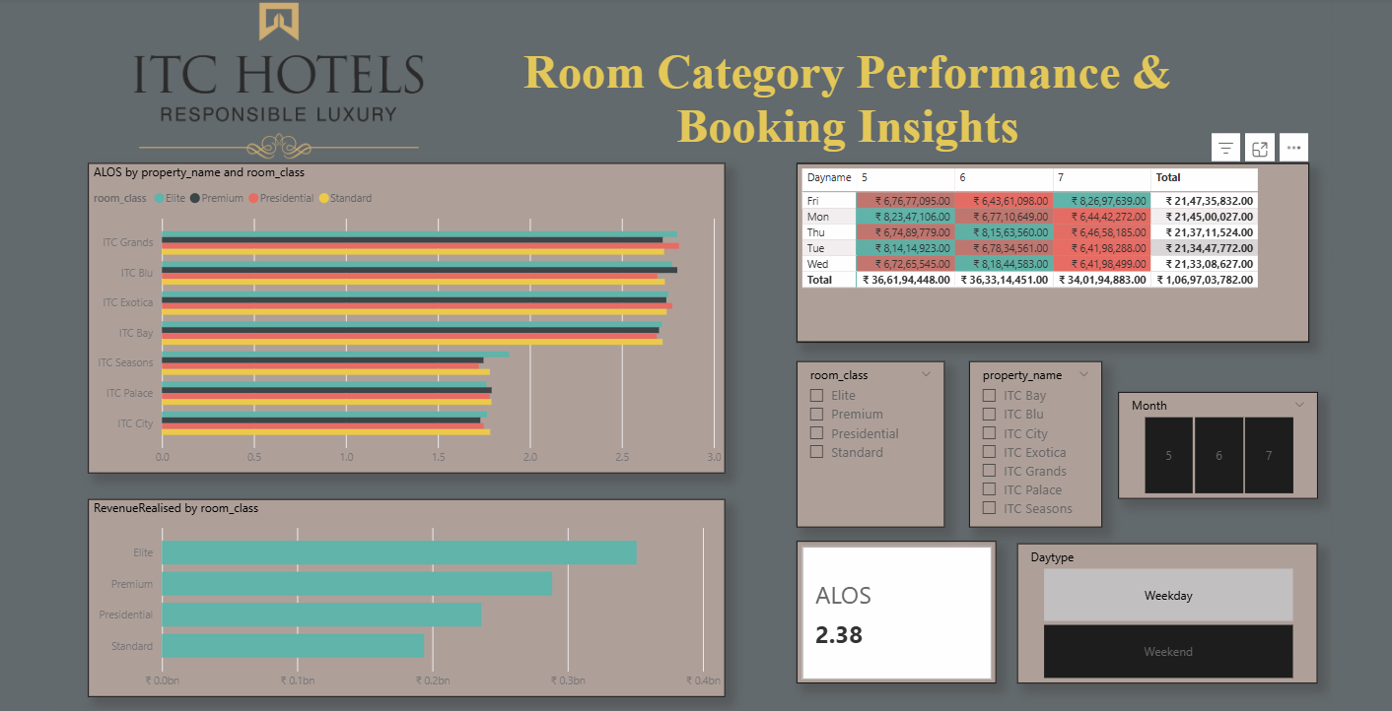

Slide 11
Elite room class generates the highest revenue, indicating strong customer preference for premium offerings.
Average Length of Stay (ALOS) is consistently around 2.38 days across properties and room classes, suggesting relatively short stays.
ITC Grand, ITC Blu, and ITC Exotica show higher ALOS compared to ITC Seasons and ITC City, suggesting stronger guest engagement at premium locations.
Revenue contribution is higher on weekdays (especially Monday and Friday), indicating that business travel demand plays a key role in bookings.

Slide 12
Cancellations & Lost Revenue Analysis

Slide 13
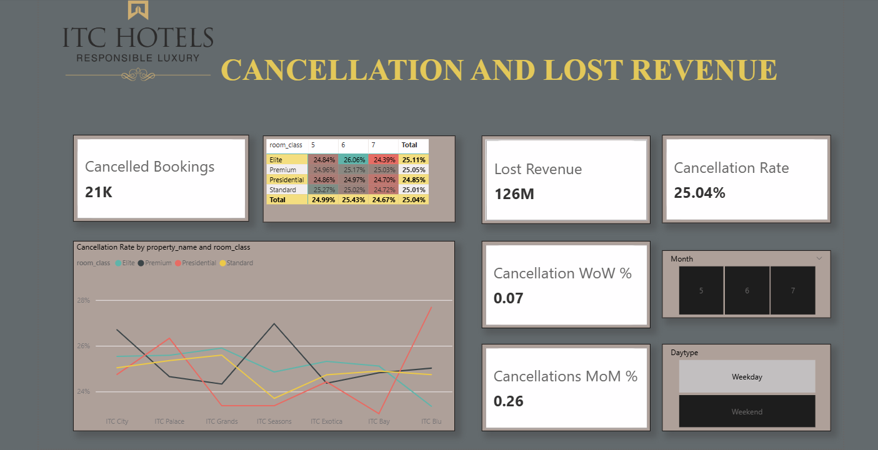

Slide 14

High Cancellation Volume & Impact: 21K bookings cancelled, resulting in a significant ₹126M revenue loss and directly impacting profitability.
Consistently High Cancellation Rate: The overall rate is 25.04%, meaning 1 in every 4 bookings is cancelled—a major operational concern.
Stable but Slightly Increasing Trend: Week-over-week (WoW) and month-over-month (MoM) changes (0.07 and 0.26) show a relatively stable but slightly rising cancellation trend.
Variation Across Properties & Room Classes: Cancellation rates differ across locations (e.g., higher spikes at ITC Blu and ITC Seasons) and room types, suggesting inconsistent demand or booking reliability.

Slide 15

Presented By -
KANISHK SHRIVASTAVA

